Slide 1
NETWORK MANAGEMENT
AND MONITORING
Developed by: Alberto Escudero Pascual, IT +46

Slide 2
Goals
We need to know what we want, to be able to know what we need
Are Monitoring and Network Management the same thing?
Do not follow tools, follow methods!

Slide 3
Table of Contents
Methodology of this unit
Goals versus Data Monitoring
Monitoring Service Goals
Technical Principles
  SNMP/MIB
  Traffic Accounting
  Traffic Shaping
  Bayesian filters
  Virus Fingerprints
Tools (MRTG, Ntop, SpamAssassin, Clam AV)

Slide 4
Methodology
Focus on goals, not tools
Understand the technical principles behind the tools
Understand which technical principles we need to achieve our goals

Slide 5
Goals versus Data monitoring
Technical
principles
Goals
Tools
Decisions

Slide 6
Monitoring Service Goals
Three examples:
Save cost by reducing International bandwidth use
Provide better QoS for VoIP
Manage Service and Network growth

Slide 7
Goal 1: Save costs in International Bandwidth

Slide 8
Goal 2: QoS for VoIP

Slide 9
Goal 3: Managing service and Network Growth

Slide 10
Technical Principles
Five technical principles:
SNMP/MIB
Traffic Accounting
Traffic Shaping
Bayesian Filters
Virus fingerprints

Slide 11


SNMP/MIB
Operation and maintenance protocol for network computer networks and network devices
Server/client architecture
Client queries remote network devices
  Statistical information, private data
SNMP-enabled device contains a statistical information database (MIB)
Interoperability and ability to be extended
Complex encoding rules, inefficient coding

Slide 12
SNMP/MIB
SNMP is also “traffic” in your network
  Minimize overhead by asking smart queries
SNMPv1 does not provide encrypted authentification
  Mind your passwords
SNMP consumes CPU

Slide 13

SNMP/MIB
Wireless vendors implement proprietary sets of wireless information in MIBs
The mechanism to retrieve certain kind of wireless data varies
Wireless devices are equipment with own “Management tools”
Integration of different management tools is normally complicated as the code seldom is open source
Write your own wireless management system!

Slide 14
Traffic Accounting
General principal for monitoring traffic statistics:
Network decisions
Troubleshooting
Monitoring host activities

Slide 15
Traffic Accounting
Packet and byte counts
Protocol distribution statistics
IP checksum errors
Discovery of active hosts
Data activity among host

Slide 16
Traffic Accounting
Active
  Enable SNMP in all routers/bridges of the network
Passive
  Promiscuous mode
  Requires direct acces to channel and CPU to gather and digest information

Slide 17
Traffic Shaping
Control traffic flow
Guarantee certain performance
Queueing disciplines in IP layer
  Latency and congestion
  Bandwidth and fairness

Slide 18
Traffic Shaping
Modification of IEEE 802.11 MAC layer in IEEE 802.11-based products to implemet similar behaviour using proprietary mechanisms that does not ensure interoperability
Proxim has implemented a proprietary polling mechanism (WORP) to allocate network capacity by using time slots

Slide 19
Queuing disciplines and latency
Applied on outgoing traffic
  Outgoing is normally bottleneck
Buffert overflow
  Dropping TCP packets ->Retransmission
  Latency
Prioritization of packets
  User interaction (ssh, rtp)
  Bulk traffic (ftp, http)

Slide 20
Bandwidth management
by packet queuing
Can ensure:
QoS
  A certain bitrate to a specific host
  Limited throughput for a specific service
Fair network
  Customer gets what he/she paid for

Slide 21
Bandwidth management
by packet queuing
Classful queuing disciplines
  Hierarchical structure
  Class specifies queueing algoritm, bitrate, ceiling limit (depending on protocol, IP, subnet)
HTB (classful)
  Controlling bandwidth by simulating slow links
SFQ (classless)
  Fairness with saturated link

Slide 22
Bayesian Filters
Content based anti-spam filter
  Header (sender and message paths)
  Embedded HTML code
  Word pairs and phrases
  Meta information
Adaptive – self lerning by error reports
No manual wordlist
  Initial list created by analysing content

Slide 23
Bayesian Filters
Place your anti-spam filter before the mails enter your wireless infrastructure
Placing mail rely agent with anti-spam filters on the other side of you international link can save 10-20% of your international bandwidth costs

Slide 24
Virus Fingerprints (signatures)
Fingerprints: Computer instructions or derivatives of them used by knows viruses
Antivirus programs
  Uses virus fingerprints to scan code
  Online constantly updated databases
Heuristic scanning algorithms
  Creates permutations of known viruses to predict future mutated viruses

Slide 25
Monitoring Tools
Free and open source tools:
MRTG
Ntop
SpamAssassin
Clam Antivirus (Clam AV)

Slide 26
Monitoring the wireless
Vendor specific monitoring tools (for certain operating system)
  Brings limited usage
N vendors implies n network monitoring tools
Single interface by integration (SNMP/MIB -> MRTG)

Slide 27
MRTG
Multi Router Traffic grapher
Monitor and display network parameters (CPU, traffic load)
Uses data from SNMP-enables devices
Graphical web based interface

Slide 28
MRTG
Configuration of MRTG:
Pre-requirements: web server, MRTG installed, IP addres and SNMP password of deviece you want to monitor
Create configuration file for MRTG (cfgmaker)
Create a “cron” process that runs MRTG

Slide 29
MRTG: Bandwidth monitoring
1. Create default config file for mrtg
> cfgmaker password@IP > /etc/mrtg_b.cfg
2. Change working directory of MRTG in mrtg_b.cfg
WorkDir: /var/www/mrtg
3. Create periodic task by adding the following line in /etc/crontab
*/5 * * * * root /usr/bin/mrtg /etc/mrtg_b.cfg

Slide 30
MRTG: SN/R monitoring
Need data from MIB of wireless device
How to find the right queries (OID)?
  Reverse engineering!
Use proprietary network manager to monitor traffic (link-test)

Slide 31
MRTG: SN/R monitoring
19:41:21.448323 10.10.10.12.1260 > 10.10.10.254.snmp:
GetRequest(29) .1.3.6.1.4.1.762.2.1.7.0
0x0000 4500 0048 77b2 0000 8011 99d5 0a0a 0a0c E..Hw...........
0x0010 0a0a 0afe 04ec 00a1 0034 64bb 302a 0201 .........4d.0*..
0x0020 0004 0670 7562 6c69 63a0 1d02 0201 0302 ...public.......
0x0030 0100 0201 0030 1130 0f06 0b2b 0601 0401 .....0.0...+....
0x0040 857a 0201 0700 0500 .z......
19:41:21.448854 10.10.10.254.snmp > 10.10.10.12.1260:
GetResponse(30) .1.3.6.1.4.1.762.2.1.7.0=2 (DF)
0x0000 4500 0049 0037 4000 4011 1150 0a0a 0afe E..I.7@.@..P....
0x0010 0a0a 0a0c 00a1 04ec 0035 62b5 302b 0201 .........5b.0+..
0x0020 0004 0670 7562 6c69 63a2 1e02 0201 0302 ...public.......
0x0030 0100 0201 0030 1230 1006 0b2b 0601 0401 .....0.0...+....

Slide 32
Connected users to AP

Slide 33
Signal & noise parameters

Slide 34
Wireless with MRTG

Slide 35
Ntop
Free and open source (GPL)
Traffic measurement
Traffic characterization and monitoring
Detection of network security violations
Network optimization and planning

Slide 36
Traffic measurement
Sent and received data per protocol
IP multicast
TCP session history
TCP/UDP services used and traffic distribution
Bandwidth utility (actual, average, peak)
Traffic distributions (among subnets)

Slide 37
Traffic characterization
and monitoring
Identifying situations where netowrk rules and thresholds are not followed by detecting:
Duplicated use of IP addresses
NICs in promiscuous mode
Misconfigurations in software
Service misuse (proxy servers etc.)
Excessible bandwidth utilization

Slide 38
Detection of network
security violations
Detection of network attacs such as:
Portscan
Spoofing
Spyes
Trojan horses
Denial of Service (DoS)

Slide 39
Network and optimization
and planning
Identify suboptimal configurations and non-efficient utilization of available bandwidth
Unnecessary protocols
Suboptimal routing (ICMP redirect)
Traffic patters and distribution

Slide 40
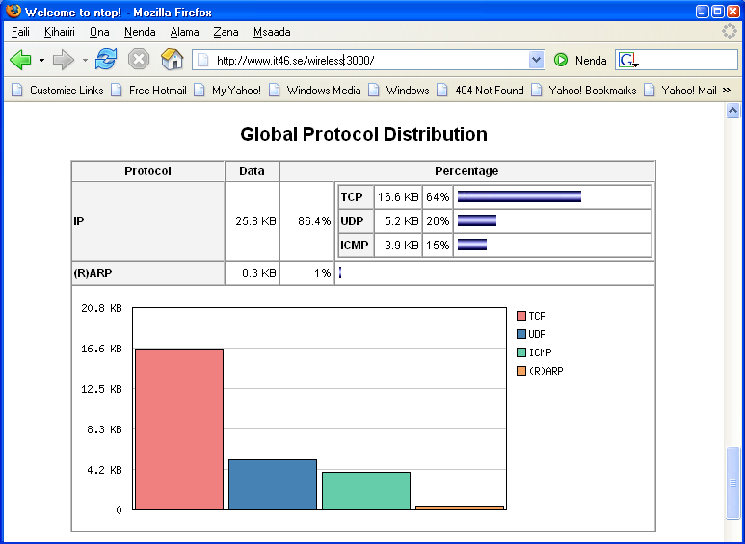
Ntop

Slide 41
SpamAssassin
Don't block, just tag!
Gives each message a score based on:
  Header and body phrases
  Bayesian filter
  Whitelists/blacklists
  Collaborative spam identification databases
  DNS blocklists
  Character sets and locales

Slide 42
Clam Antivirus
Does not delete or clean infected file, just tags it
Fast scanning of directories and file
Detection of over 30 000 viruses, worms and trojan horses
Scans archives and compressed files
Contains advanced database updater with support for virus signatures

Slide 43
Flooding the network
18:12:36.432838 172.168.0.36.2231 > 172.168.82.53.445: S 1068540375:1068540375(0) win 64240 <mss 1460,nop,nop,sackOK> (DF)
0x0000 4500 0030 119f 4000 8006 3d7f aca8 0024 E..0..@...=....$
0x0010 aca8 5235 08b7 01bd 3fb0 a1d7 0000 0000 ..R5....?.......
0x0020 7002 faf0 f088 0000 0204 05b4 0101 0402 p...............
18:12:36.441460 172.168.0.23.1433 > 172.168.227.122.445: S 2018273998:2018273998(0) win 64240 <mss 1460,nop,nop,sackOK> (DF)
0x0000 4500 0030 8a9c 4000 8006 3349 aca8 0017 E..0..@...3I....
0x0010 aca8 e37a 0599 01bd 784c 6ace 0000 0000 ...z....xLj.....
0x0020 7002 faf0 60db 0000 0204 05b4 0101 0402 p...`...........
18:12:36.441731 172.168.0.23.1435 > 172.168.196.106.445: S 2018316905:2018316905(0) win 64240 <mss 1460,nop,nop,sackOK> (DF)
0x0000 4500 0030 8a9d 4000 8006 5258 aca8 0017 E..0..@...RX....
0x0010 aca8 c46a 059b 01bd 784d 1269 0000 0000 ...j....xM.i....
0x0020 7002 faf0 d84d 0000 0204 05b4 0101 0402 p....M..........
18:12:36.443252 arp who-has 172.168.0.247 tell 172.168.0.27
0x0000 0001 0800 0604 0001 0006 5ba6 3815 aca8 ..........[.8...
0x0010 001b 0000 0000 0000 aca8 00f7 0000 0000 ................
0x0020 0000 0000 0000 0000 0000 0000 0000 ..............
18:12:36.445470 172.168.0.27.2367 > 172.168.160.143.445: S 767169456:767169456(0) win 64240 <mss 1460,nop,nop,sackOK> (DF)
0x0000 4500 0030 3f8b 4000 8006 c141 aca8 001b E..0?.@....A....
0x0010 aca8 a08f 093f 01bd 2dba 13b0 0000 0000 .....?..-.......
0x0020 7002 faf0 41cd 0000 0204 05b4 0101 0402 p...A...........
18:12:36.447728 172.168.0.36.2235 > 172.168.217.194.445: S 1068598455:1068598455(0) win 64240 <mss 1460,nop,nop,sackOK> (DF)
0x0000 4500 0030 11a0 4000 8006 b5f0 aca8 0024 E..0..@........$
0x0010 aca8 d9c2 08bb 01bd 3fb1 84b7 0000 0000 ........?.......
0x0020 7002 faf0 8616 0000 0204 05b4 0101 0402 p...............
18:12:36.448124 172.168.0.36.2232 > 172.168.97.176.445: S 1068654094:1068654094(0) win 64240 <mss 1460,nop,nop,sackOK> (DF)
0x0000 4500 0030 11a1 4000 8006 2e02 aca8 0024 E..0..@........$
0x0010 aca8 61b0 08b8 01bd 3fb2 5e0e 0000 0000 ..a.....?.^.....
0x0020 7002 faf0 24d4 0000 0204 05b4 0101 0402 p...$...........

Slide 44
Conclusions
Monitoring raw data will not help
You need to monitor to have a good network managment
Set your goals, find the technical principles and then choose your tools
If a tool does NOT do what you want or does far more of what you need, consider building one.

